Slide 1

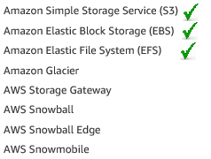
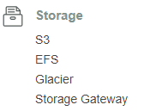
AWS Storage

Slide 2
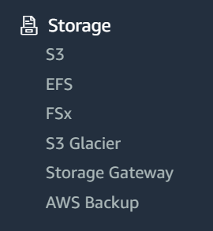
AWS Storage

Slide 3

Amazon S3 Simple Storage Service

Slide 4
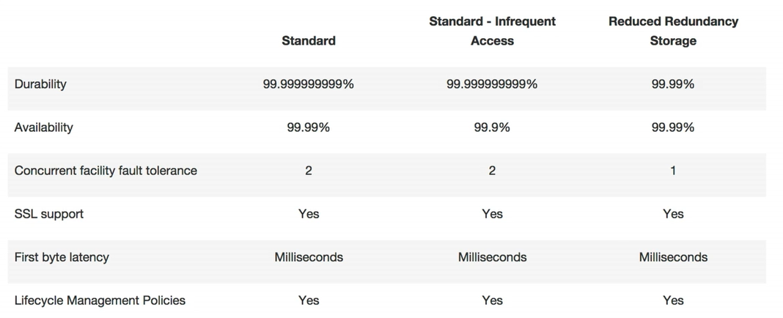
Amazon S3 Simple Storage Service

Slide 5
Amazon S3 Simple Storage Service
S3 > Object storage, we can’t store OS file.
File size can be between 0-5 TB’s
Unlimited storage, no limitation of size
Files are stored in Buckets (Buckets is name of folder)
Bucket name must unique globally
https://s3-eu-west-1.amazonaws.com/nameofbucker
Read after write consistency PUTS of new Objects (immediately available for read)
Eventual Consistency for overwrite PUT’S & DELETES (tack some time to read)
After successfully upload it will response back HTTP 200
AWS S3 FAQ
Notes:
S3 > Object storage, we cant store OS file.
File size can be form 0 -5 TB’s
Unlimited storage, no limitation of size
Files are stored in Buckets
Bucket name must unique globally
http or https://s3-eu-west-1.amazonaws.com/nameofbucker
Read after write consistency PUTS of new Objects (immediately available for read)
Eventual Consistency for overwrite PUT’S & DELETES (tack some time to read)

Slide 6

Amazon EBS Elastic Block Store
Persistent block storage for Amazon EC2 delivering capabilities and performance for the most demanding applications
Notes:
Note: we cant attached same block volume to more then one ec2 instance
But we can do with EFS, same mount point will share with n number of instances.

Slide 7
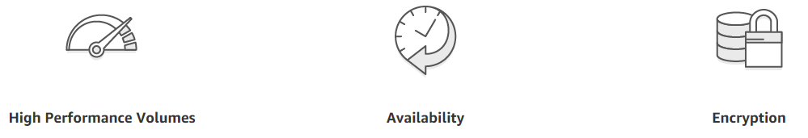
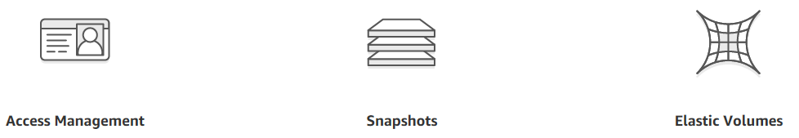
Amazon EBS Features

Slide 8
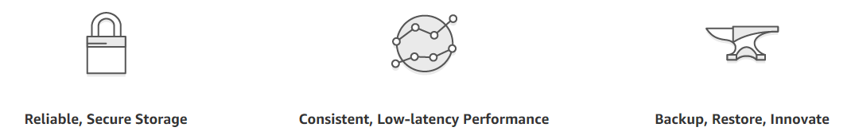
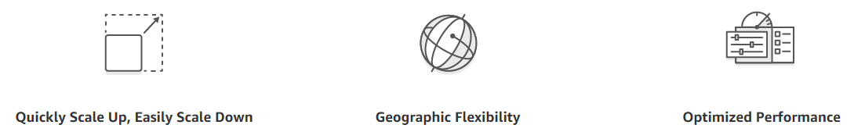
Amazon EBS Benefits

Slide 9

Elastic File System (EFS)
Scalable, reliable, and elastic file storage for the AWS Cloud

Slide 10
Elastic File System (EFS)

Slide 11
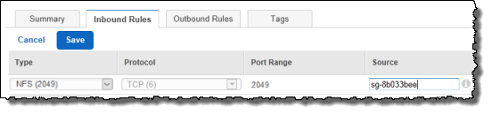
Elastic File System (EFS)
Important
You should always unmounts a file system before you delete it.
Use default SG or define and allows below port access:
https://docs.aws.amazon.com/efs/latest/ug/security-considerations.html
Notes:
https://aws.amazon.com/efs/?p=tile
https://docs.aws.amazon.com/efs/latest/ug/security-considerations.html
https://docs.aws.amazon.com/efs/latest/ug/manage-delete-fs.html

Slide 12
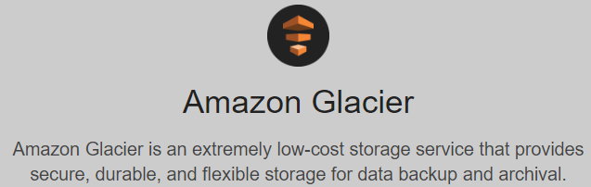
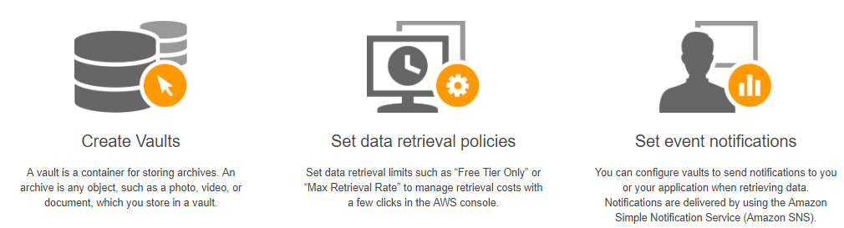
Amazon Glacier
Notes:
https://docs.aws.amazon.com/amazonglacier/latest/dev/amazon-glacier-getting-started.html
Important
Amazon Glacier provides a management console, which you can use to create and delete vaults. However, all other interactions with Amazon Glacier require that you use the AWS Command Line Interface (CLI) or write code. For example, to upload data, such as photos, videos, and other documents, you must either use the AWS CLI or write code to make requests, using either the REST API directly or by using the AWS SDKs. For more information about using Amazon Glacier with the AWS CLI, go to AWS CLI Reference for Amazon Glacier. To install the AWS CLI, go to AWS Command Line Interface.

Slide 13

Amazon Glacier
Amazon Glacier is a secure, durable, and extremely low-cost cloud storage service for data archiving and long-term backup. It is designed to deliver 99.999999999% durability, and provides comprehensive security and compliance capabilities that can help meet even the most stringent regulatory requirements. Amazon Glacier provides query-in-place functionality, allowing you to run powerful analytics directly on your archive data at rest. Customers can store data for as little as $0.004 per gigabyte per month, a significant savings compared to on-premises solutions. To keep costs low yet suitable for varying retrieval needs, Amazon Glacier provides three options for access to archives, from a few minutes to several hours.
Note: a single archive can be as large as 40 TB’s

Slide 14
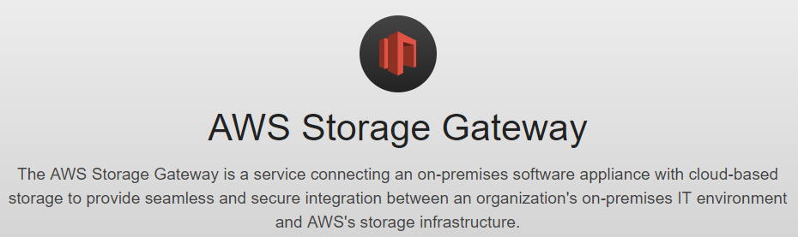
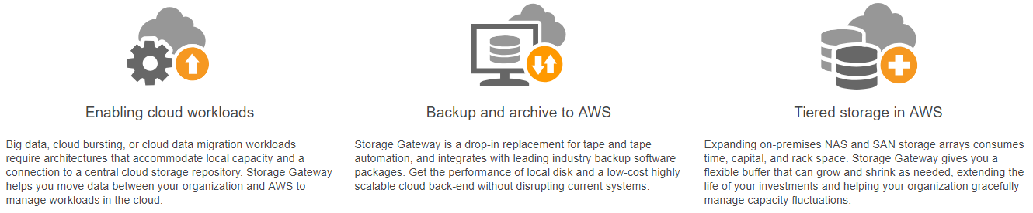
AWS Storage Gateway

Slide 15
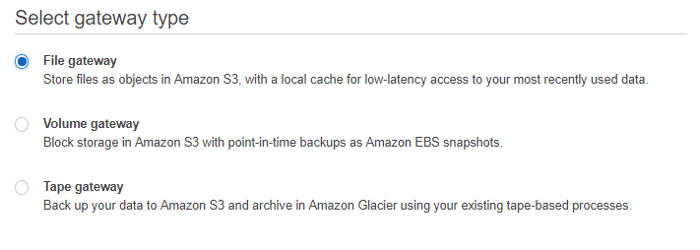
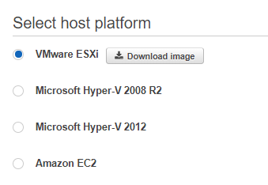
AWS Storage Gateway

Slide 16

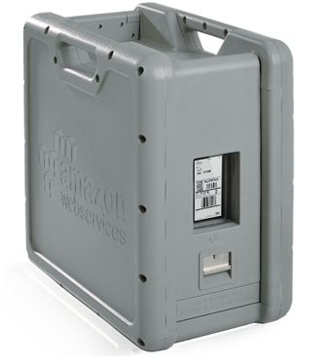
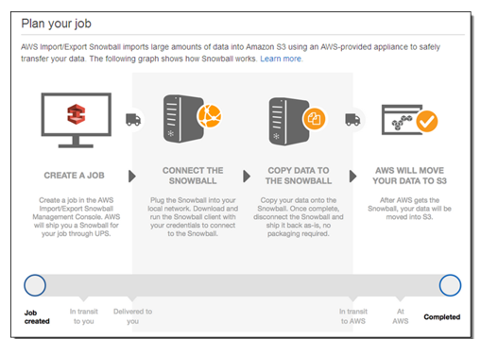
AWS Snowball

Slide 17
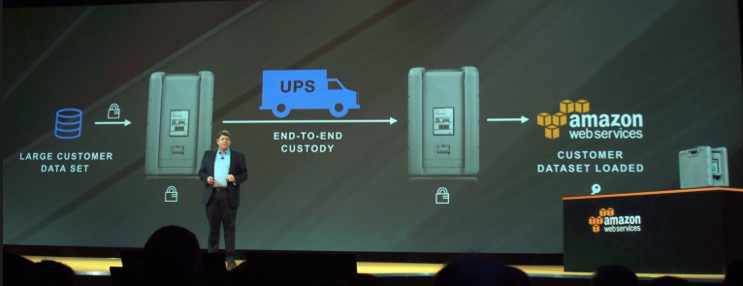
AWS Snowball

